Slide 1
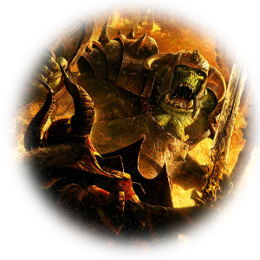



Slide 2
What is RPG?
Living an epic story together with your friends
The game master writes the scenario
Other players = heroes of the story
Playing by Talking
GM describes the World
Players tell GM what their hero does
Players speaks hero; GM speaks other characters

Slide 3
Dices rule
Heroes  Gods
Rules to decide whether they succeed in actions
Battle rules=heavy Lose rythm

Slide 4
The App Advantage
Warhammer
Our app
Need to meet same people several times
Lot of materials (Books, notes, dices)
Complex rules to compute stats
Recalculate stats regularly
Speak with your friends without physical present
Only your phone or tablet
All computing in the app
Easy to change character’s stats
Simply Play!

Slide 5
Business Model
Target: Warhammer initiated players
Pricing: Copyright infringement!
Sell to Games Workshop
Free and free of ads (by players for players)
Distribution Channel
On dedicated sites, e.g warhammer-forum.com
On google app store

Slide 6
Business Model (cont)
Competitors
Android: utilities (dices, army stats, few computing)
iOs: donjon crawler, utilities
Slogan: Let the Old World enter your Mobile
Keywords: Warhammer, dice, battle computation, character stats

Slide 7
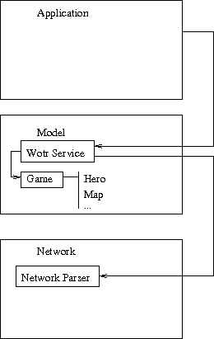
Architecture: client side

Slide 8
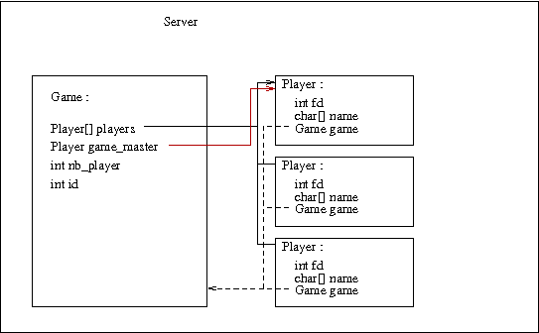
Architecture: server side

Slide 9
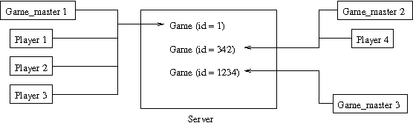
Architecture: overall

Slide 10
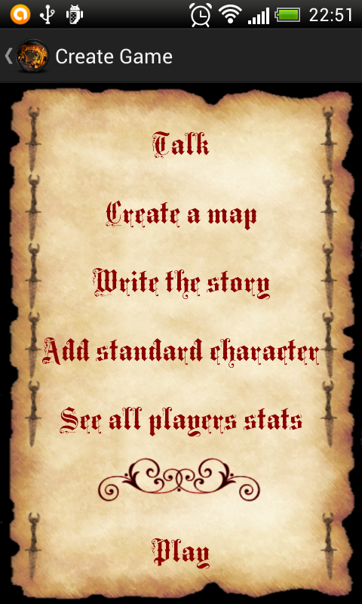
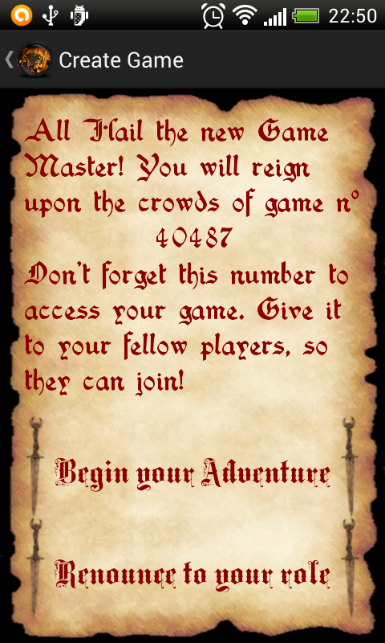
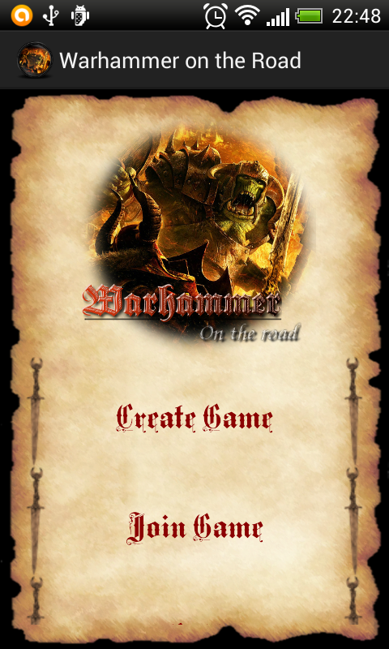
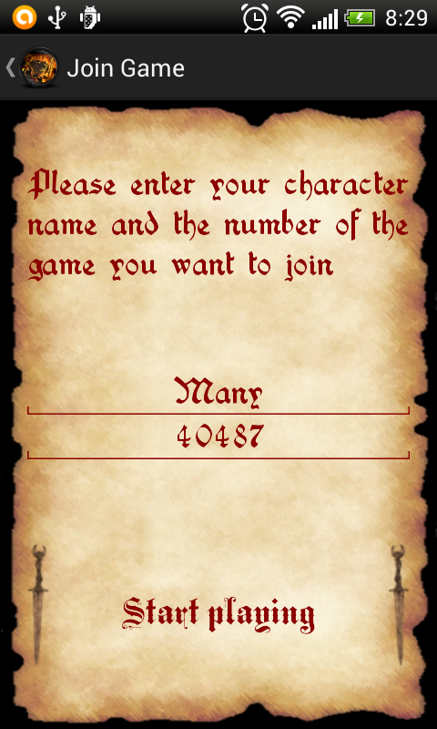
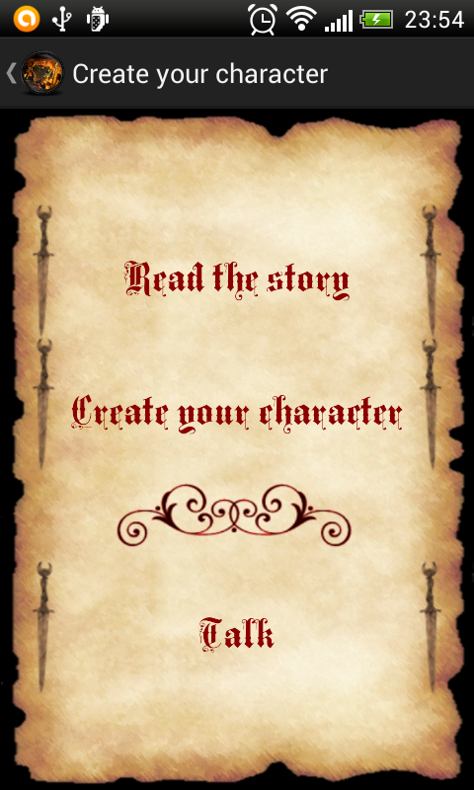
UI Design
GM
Player

Slide 11
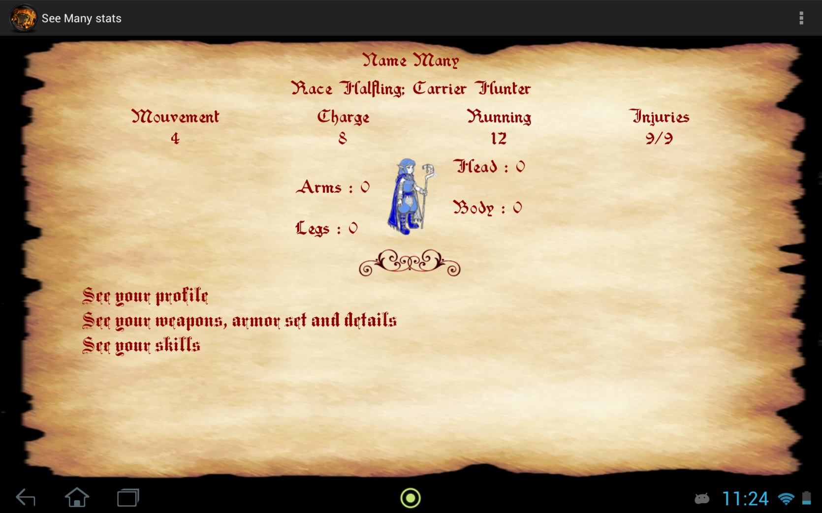
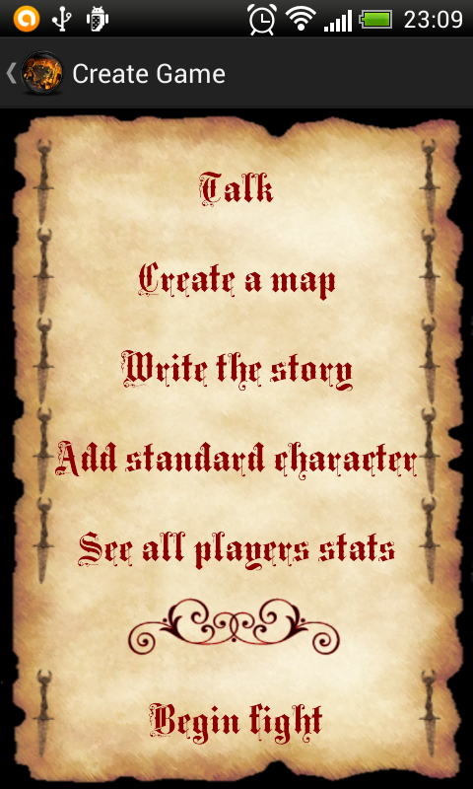
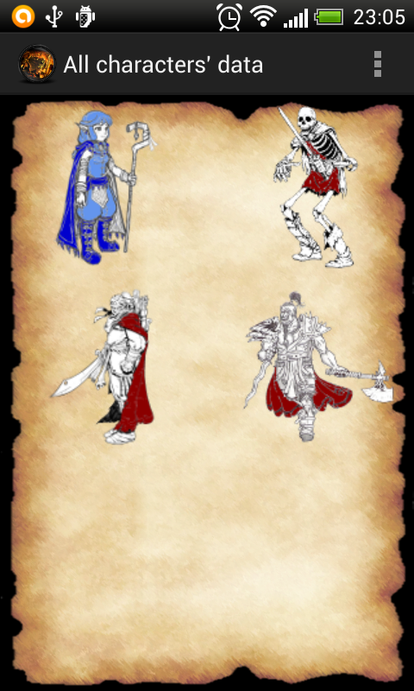
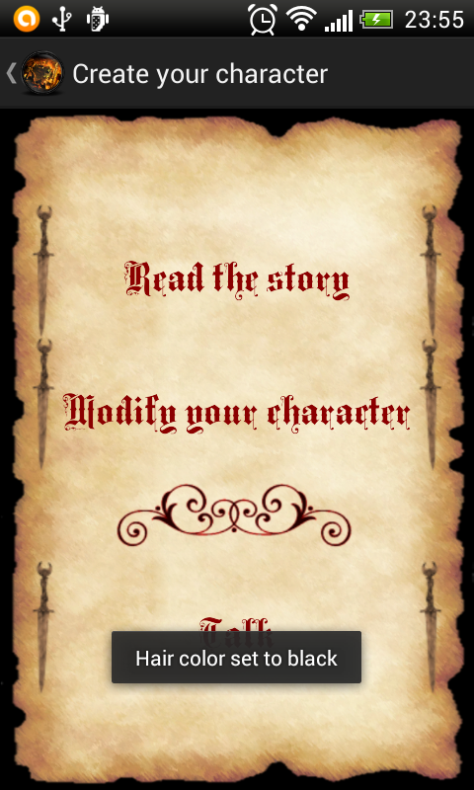
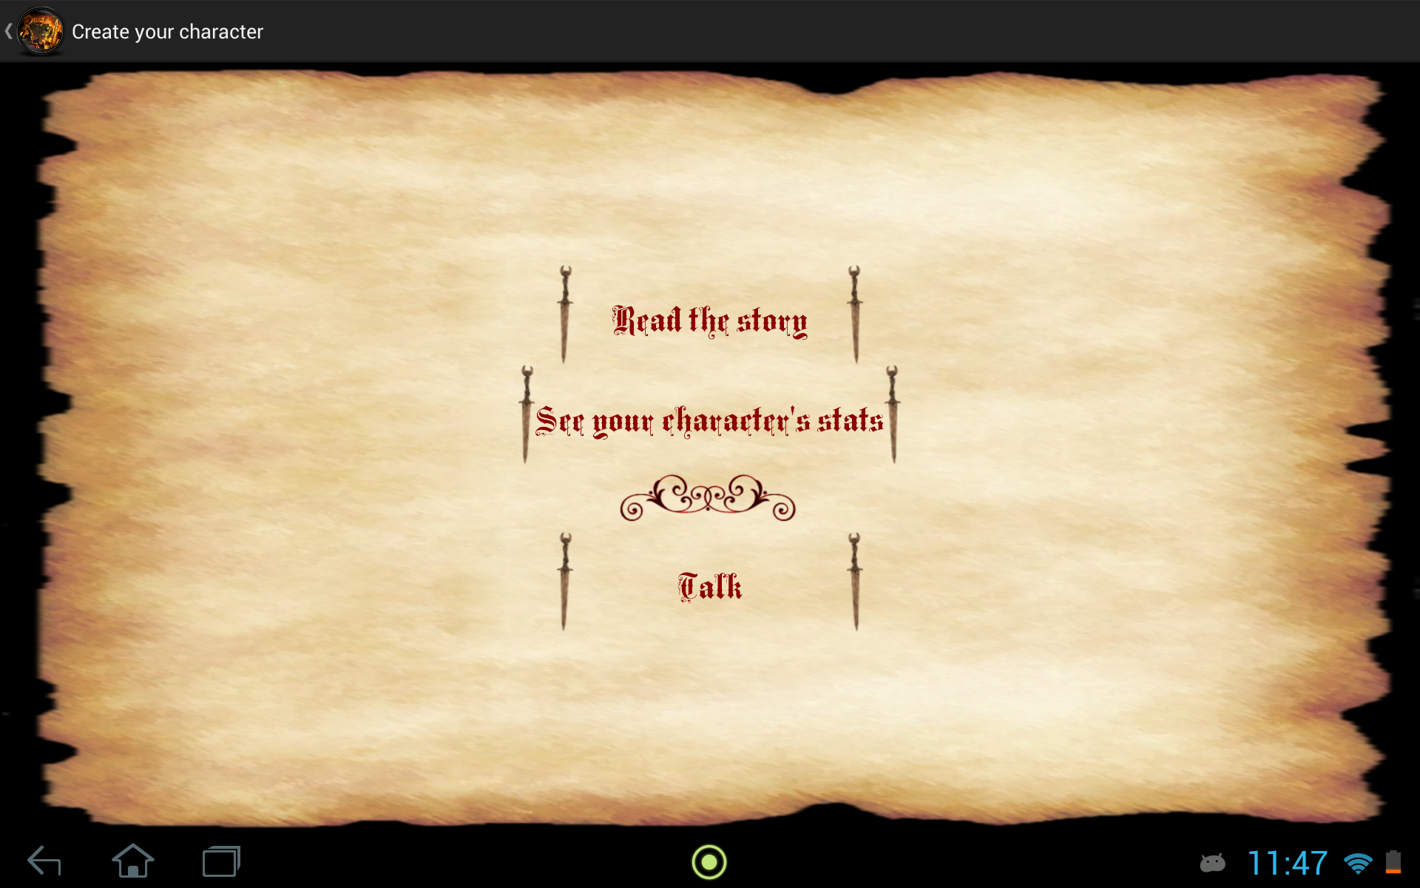

Slide 12
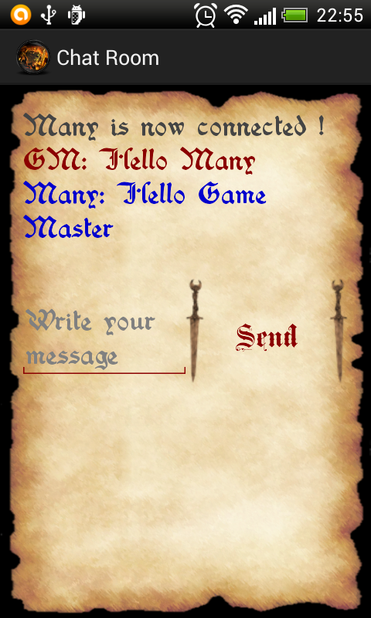
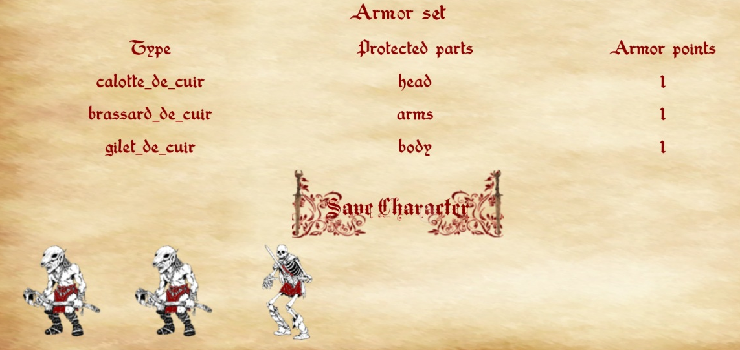
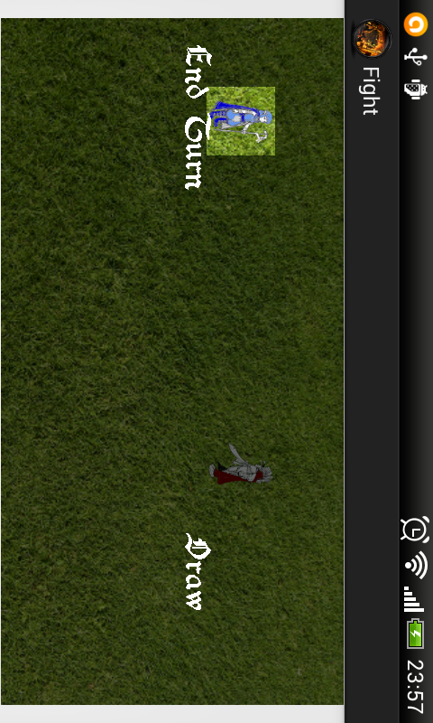

Slide 13
Use Case
Group of friends wants to play at Warhammer
Game master create game and send number to all players
Players join the game and start creating their characters, then play
Active chat and intense battle

Slide 14
Methodology
Software: model, view, controller
Group work: versioning with Git
Functionality testing, black box testing

Slide 15
Management
Group democratic decision making
One release, alpha version
Internal tests
Task attribution:
Adrien: core development (model)
Florian: core development (network, controller, battle interface)
Elsa: UI designer

Slide 16
Project Advancement
Done
Log in
Character creation
Battle interface
Chat room
Half-done
Skills tests
Utility button (avoid going back to menu)

Slide 17
Project Advancement
Not done
Map creation
Read/Write story
Character evolution
Disconnection/Reconnection power saving
In a perfect world
Talents and other rules
Shops
Cities
Heavy load on server

Slide 18
Project Advancement
Not done
Map creation
Read/Write story
Character evolution
Disconnection/Reconnection power saving
In a perfect world
Talents and other rules
Shops
Cities
Heavy load on server

Slide 19
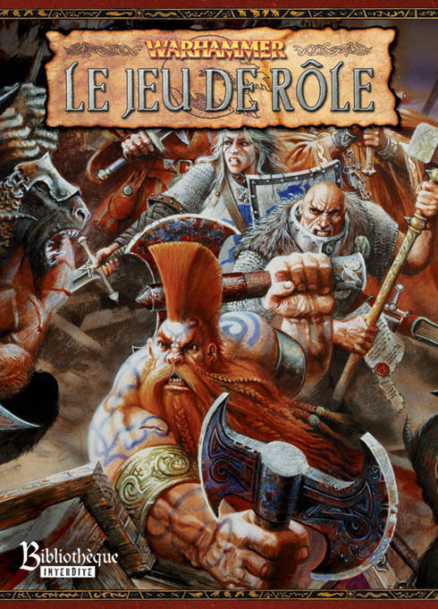
References
Warhammer rule book
http://developer.android.com

Slide 20
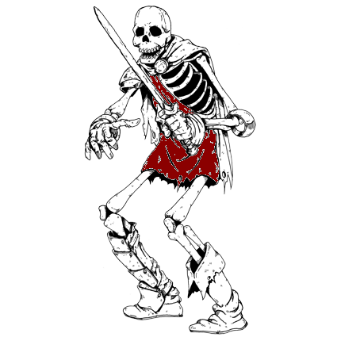
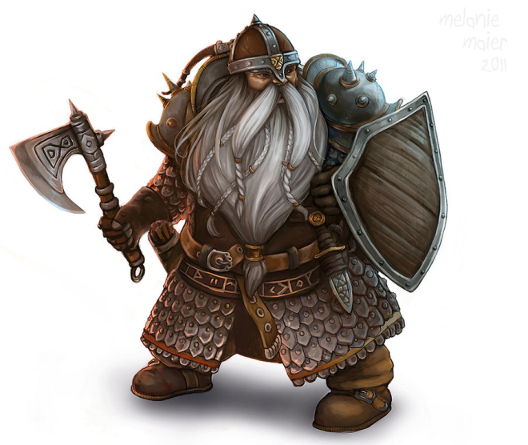
Demonstration!

